Slide 1
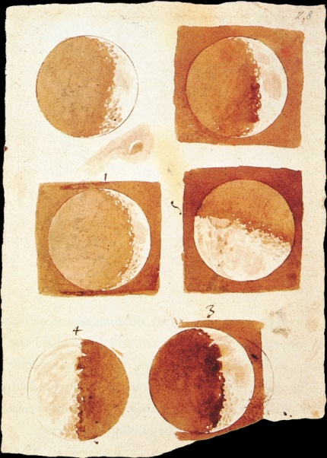
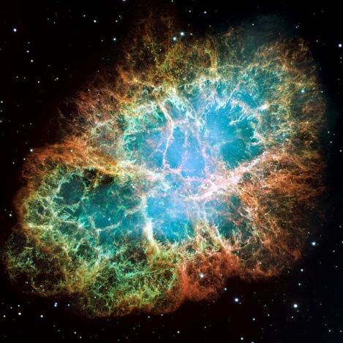
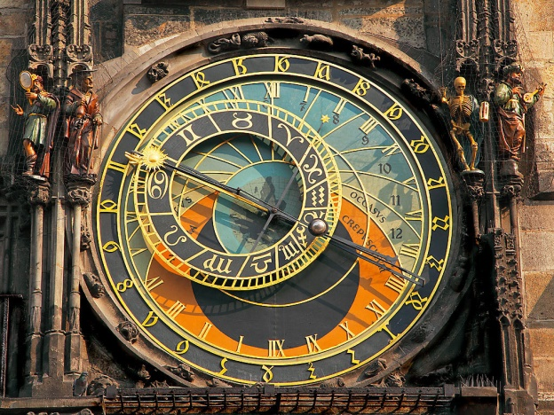
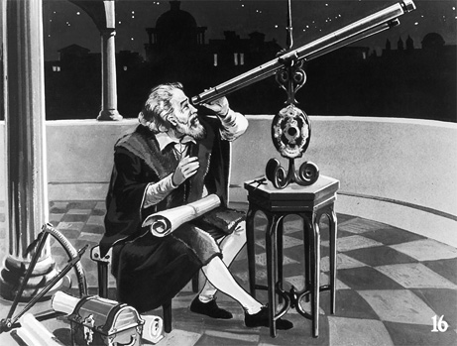
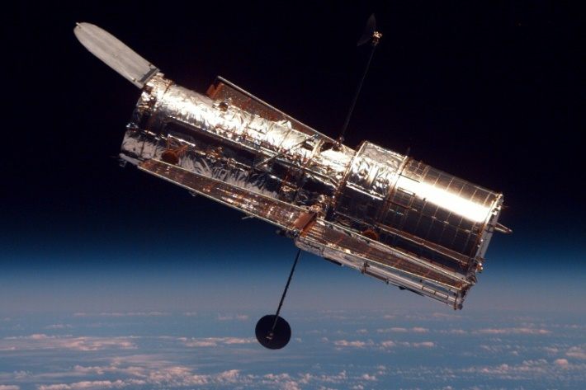
Astronomy Demystified
- Ruturaj Atre

Slide 2
Astronomy – the oldest science
The origin of physics
1. The earth is round
2. Planets revolve around the Sun
3. The physics governing the motion of the moon around the earth is the same as that for an apple falling from a tree
Humans have always been a curious specie.
We hardly wonder how these simple facts about the universe were discovered.

Slide 3
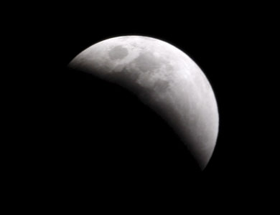
How did we know that the earth is round?

Slide 4
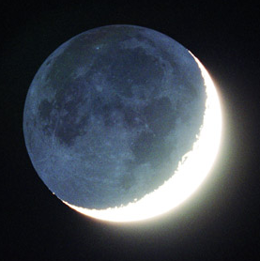
The Dark of the Moon.
Why not so dark?
Earthshine
Light reflected from the surface of the earth onto the moon

Slide 5
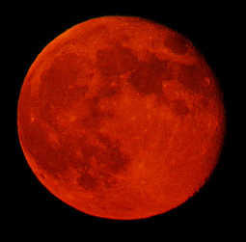
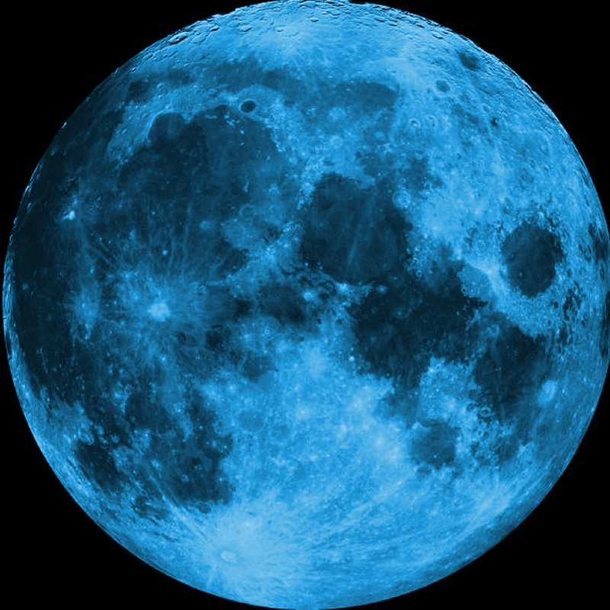
Blue Moon vs Red Moon

Slide 6
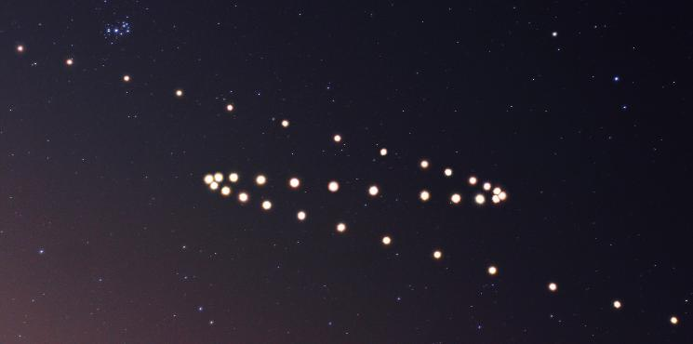
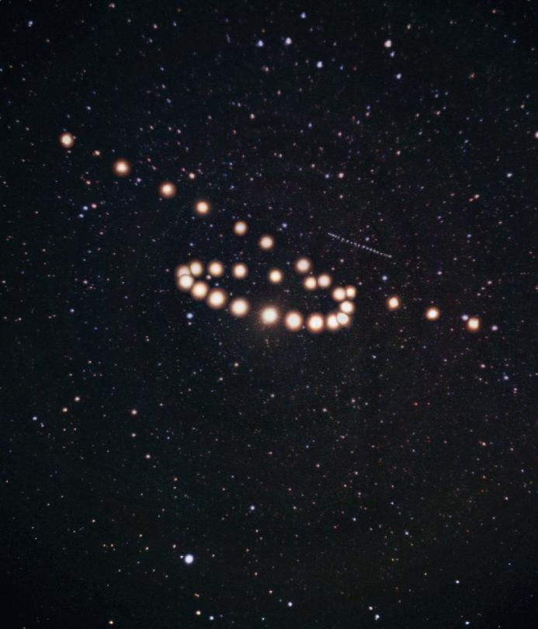
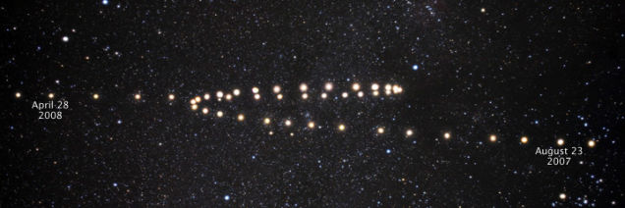
The retrograde loops of Mars

Slide 7
Any theory should explain the following things:
Why is retrograde motion seen for exterior planets alone?
How do you explain this abnormal motion?
What can you conclude from these observations?
Geocentric model or heliocentric model

Slide 8
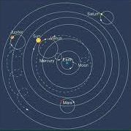
The geocentric model

Slide 9
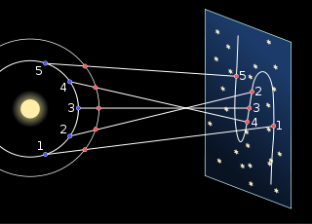
Heliocentric model
can explain the retrograde loops
Kepler studied these retrograde loops to derive his three famous laws

Slide 10
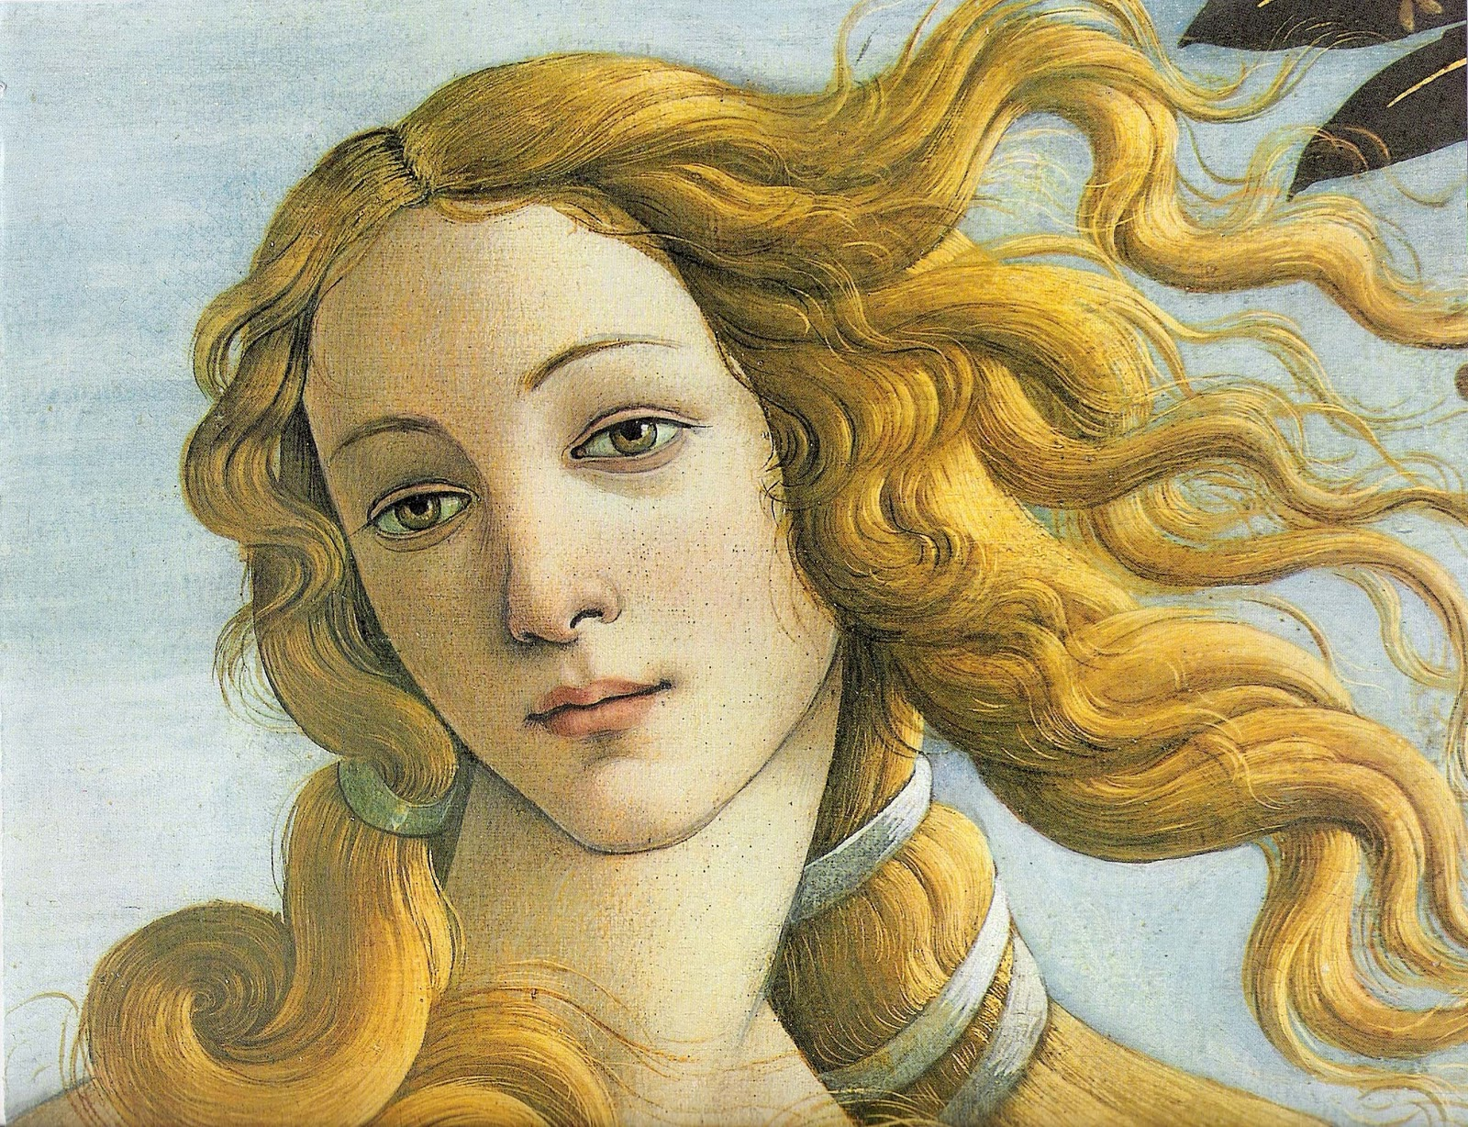
Botticelli’s painting. Who is he depicting?

Slide 11
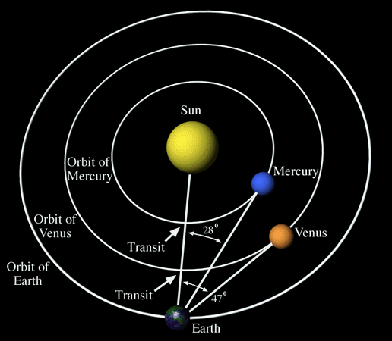
Venus!
The morning or evening star

Slide 12
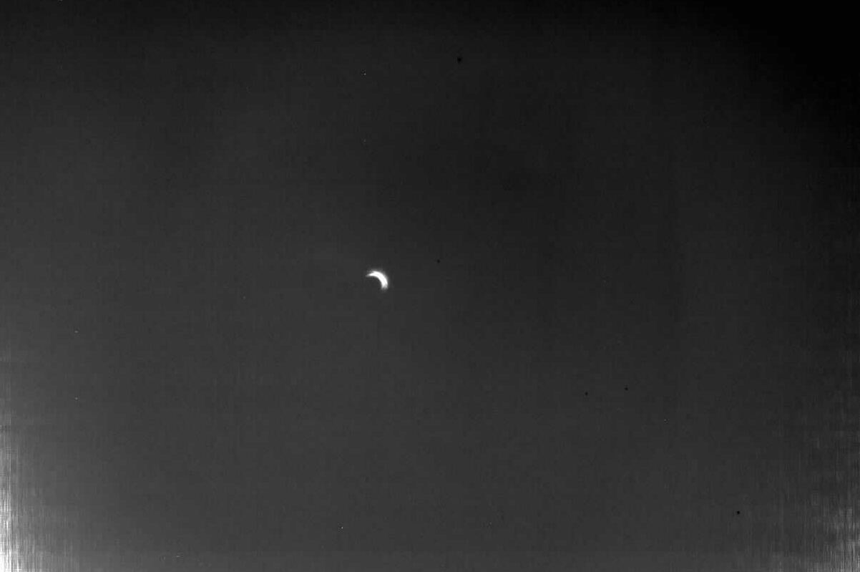
Phases of Venus

Slide 13
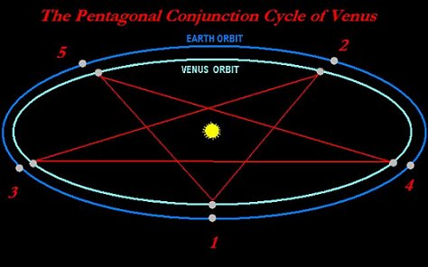
Venus in the DaVinci Code
“The planet Venus traces a perfect pentacle across the ecliptic sky every eight years.”

Slide 14
Astronomical evidence for Mahabharat!
Conjunction of Saturn with Aldebaran
Retrograde motion of Mars just before it reaches Antares
A lunar eclipse near Pleiades (Krittika)
Followed by a solar eclipse

Slide 15
A lot of questions have been answered. A lot more remain to be answered.
The search for exoplanets and extra terrestrial life
What happened before the big bang
What is the future of our universe
What is dark matter and dark energy
Can Mars habitat human life
Radio astronomy
and many many more!

